Slide 1

Schools equipment inventory system of Abellana national school tech-voc department with barcode
Nathaniel Angelico B. Tabanao
Jamie Hanna S. Dionson
Allyssa Ray G. Sericon
John Brown R. Geonson

Slide 2
What is Abellana national school?

Slide 3
Statement of the Problem
This study aims to identify the problems of the current manual process of being used for Schools Equipment Inventory System of Abellana National School Tech-Voc Department
Specifically, the researchers will attempt to provide a solution to the following
Data Inaccuracy
Time Inefficiency
Duplication of Records
Indeterminate Monitoring of Equipment

Slide 4
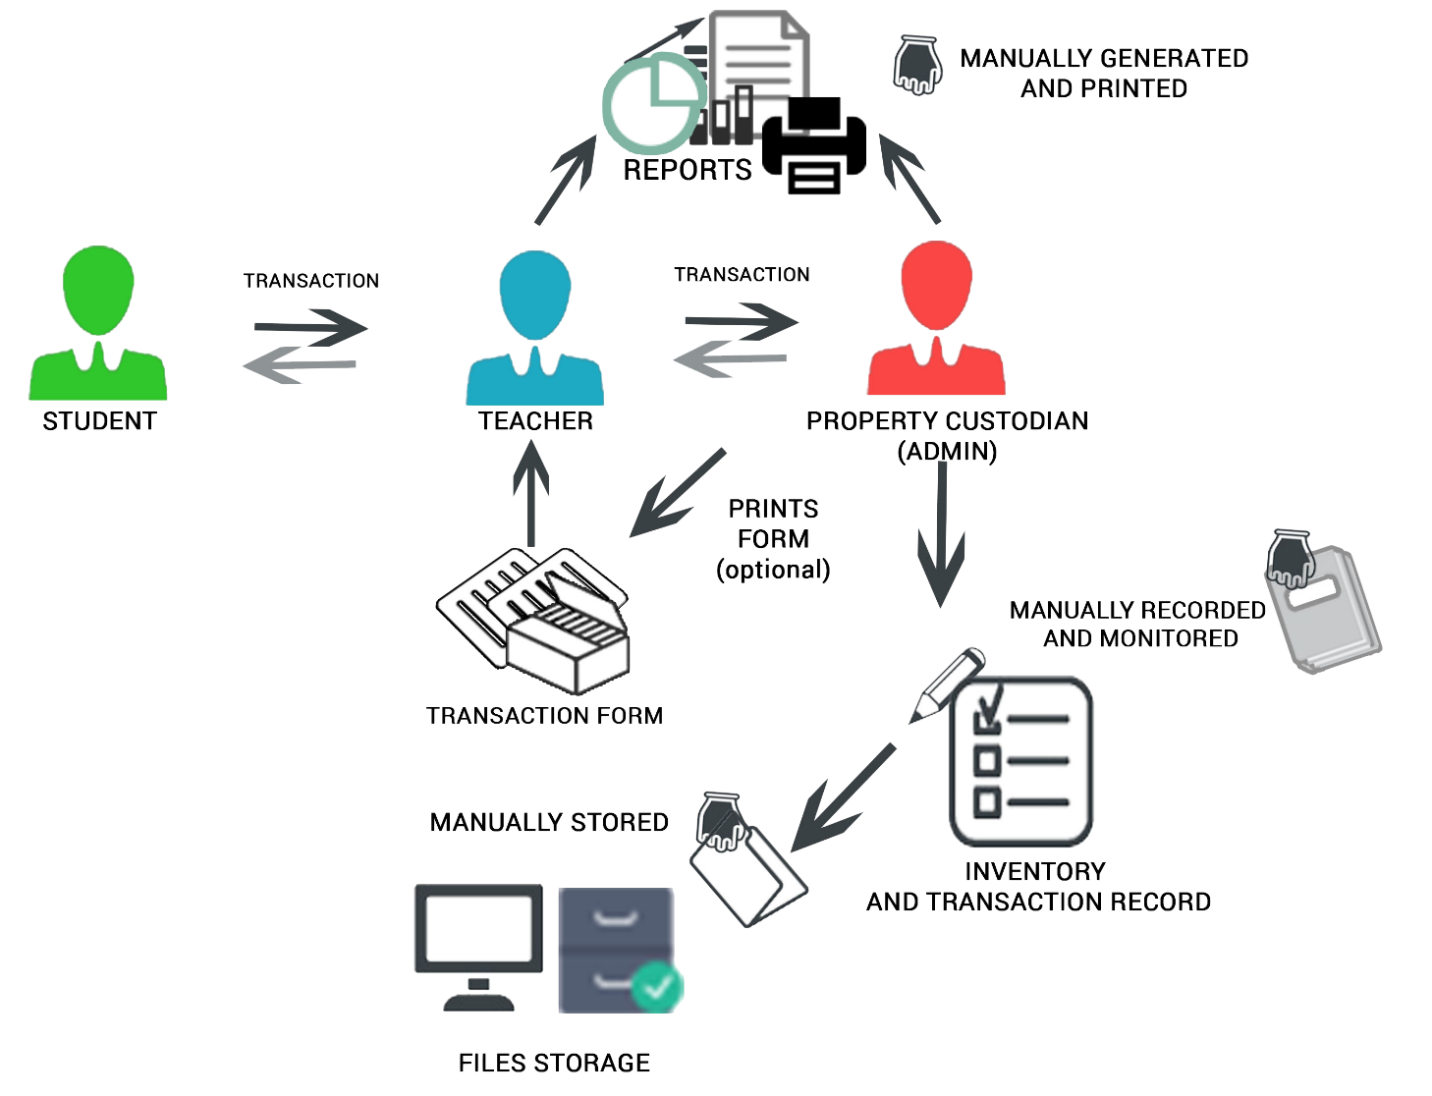
Current flow of the system

Slide 5
What is Schools equipment inventory system?

Slide 6
Objectives of the System
This study was developed with general objectives which aim to provide solutions to the problems that arise in using the manual system.
Specifically, the study aims to provide:
Accurate data of the current inventory and monitoring of equipment.
Help to the key personnel to minimize amount of time consumed for the process.
Updated records of equipment.
Definite records of monitored equipment.

Slide 7
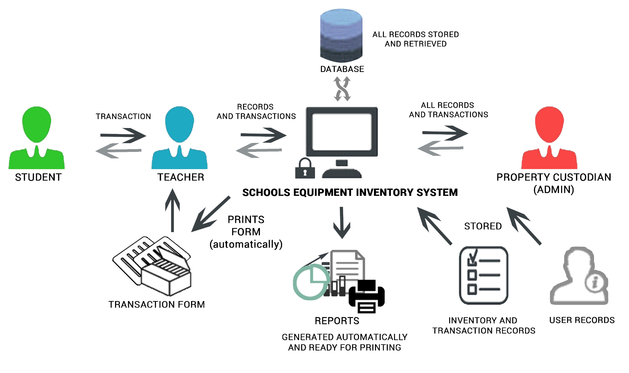
proposed flow of the system

Slide 8
Scope and Limitation
The study involves the Schools Equipment Inventory System of the Tech-Voc Department of Abellana National School. The design of the system includes the following;
1. Maintain the following data:
1.1. User
1.1.1. Administrator (Property Custodian)
1.1.2. Teacher
1.1.3. Student
1.2. Equipment

Slide 9
2. Processing of the following:
2.1. Authenticating Users
2.2. Recording of registration
2.2.1. Users
2.2.3. Equipment
2.3. Borrowing and returning of equipment
2.3. Borrowing and returning of equipment
2.4. Accepting of equipment reservation
2.5. Recording of pull-out and deployment of equipment
2.6. Requesting of new equipment
2.7. Inventory of equipment
2.8. Importing and exporting records to a spreadsheet file

Slide 10
3. Monitor the following equipment:
3.1. Borrowed
3.2. Requested
3.3. Pulled-out
3.4. Reserved
3.5. Deployed
3.6. Inventory

Slide 11
4. Generate the following reports:
4.1. Inventory of equipment
4.2. Equipment Status
4.2.1. Borrowed
4.2.2. Returned
4.2.3. Functional
4.2.4. Damaged
4.2.5. Reserved
4.2.6. Requested
4.2.7. Pulled-out
4.2.8. Deployed

Slide 12
However, the system is not capable of the following:
1. Managing the purchasing processes for the new equipment.
2. Sharing data through network.
3. SMS Notification to users.

